Slide 1
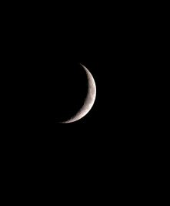
Look! It’s a Bird!
It’s a Plane!
It’s an Exoplanet!
Eva Chow and Benjamin Earnest

Slide 2

PROBLEM STATEMENT
Using data from the Kepler Telescope, build model to predict if new observations are an exoplanet

Slide 3
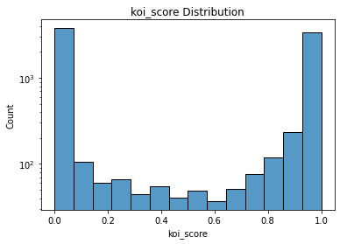
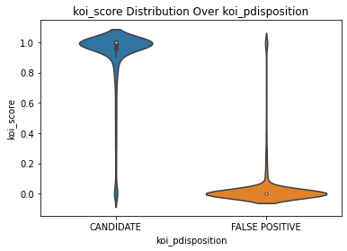
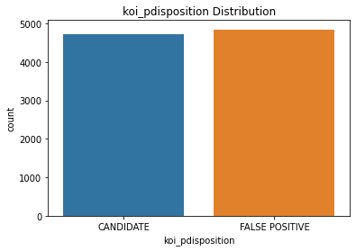
EXPLORATORY DATA ANALYSIS
9, 564 Observations
49 total variables
Target: ‘koi_pdisposition’
Identifies if an observation is a ‘Candidate’ or ‘False Positive’
820 observations with missing data

Slide 4
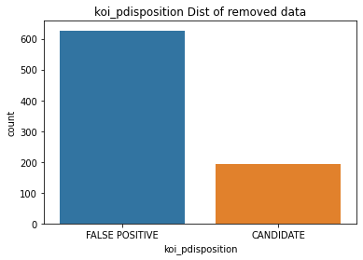
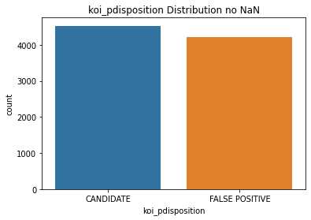
PREPROCESSING AND SPLITTING
For observations with missing data, target distribution was largely “False Positive”.
Removed the 820 observations, and checked target distribution.
Still balanced
Also removed irrelevant columns.
Any scaling, centering, etc. done based on model
New data set shape: 8,744 observations, 37 Variables (including target)

Slide 5
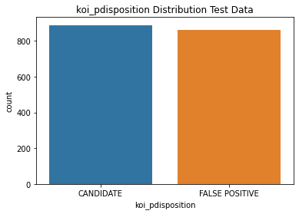
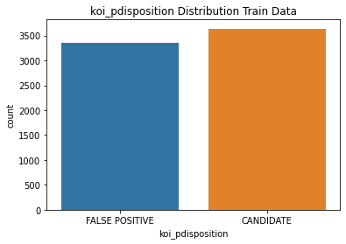
PREPROCESSING AND SPLITTING
Data split for modeling was done using the “train_test_split” method in the sklearn library.
80/20 split used
Training data included 6,995 observations
Test data included 1,749 observations
36 variables retained (not including target)
Balance maintained for both the training and test data

Slide 6
MODEL BUILDING STRATEGIES
Target variable is categorical/Binary – Classification problem
Hyperparameter Tuning
Cross Validation
Linear Models
Perceptron
Logistic Regression
Support Vector Machine
Stochastic Gradient Descent
Non-Linear Models:
K-nearest neighbors
Decision Tree
Random Forest

Slide 7
LINEAR MODELS - PERCEPTRON
Preprocessing:
Target changed to 1 or -1
Hyperparameters
Used “best_params” method to optimize
Max_iter = 5
Results:
Confusion Matrix
Accuracy = 0.718
 | False Positive | Candidate
False Positive | 854 | 34
Candidate | 460 | 401

Slide 8
LINEAR MODELS – LOGISTIC REGRESSION
Preprocessing:
Remove Near Zero Variance Predictors
Remove highly correlated predictors
Center and scale data
Hyperparameters
Used “best_params” method to optimize
C = 1000
Fit_intercept = True
Results:
Confusion Matrix
Accuracy = 0.818
 | False Positive | Candidate
False Positive | 759 | 129
Candidate | 190 | 671

Slide 9
LINEAR MODELS – SUPPORT VECTOR MACHINE
Preprocessing:
Center and scale data
Hyperparameters
Used “best_params” method to optimize
C = 1000
Gamma = 0.001
Kernel = rbf
Results:
Confusion Matrix
Accuracy = 0.851
 | False Positive | Candidate
False Positive | 774 | 114
Candidate | 147 | 714

Slide 10
LINEAR MODELS – STOCHASTIC GRADIENT DESCENT
Preprocessing:
Scale data
Hyperparameters
Used “best_params” method to optimize
Loss = hinge
Alpha = 0.001
Learning rate = optimal
Max_iter = 100
Results:
Confusion Matrix
Accuracy = 0.833
 | False Positive | Candidate
False Positive | 795 | 93
Candidate | 199 | 662

Slide 11
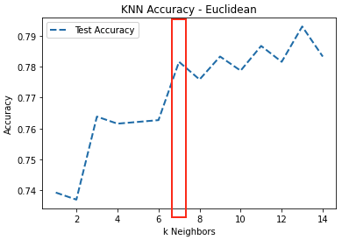
NON-LINEAR MODELS - KNN (Euclidean)
Hyperparameters
metric=’Euclidean’
k=7
Results:
Confusion Matrix
Accuracy = 0.782
 | False Positive | Candidate
False Positive | 740 | 148
Candidate | 234 | 627

Slide 12
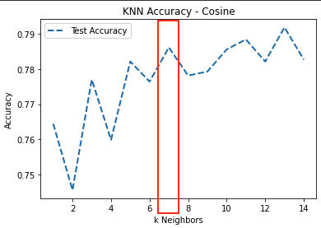
NON-LINEAR MODELS - KNN (Cosine)
Hyperparameters
metric=’cosine’
k=7
Results:
Confusion Matrix
Accuracy = 0.786
 | False Positive | Candidate
False Positive | 737 | 151
Candidate | 223 | 638

Slide 13
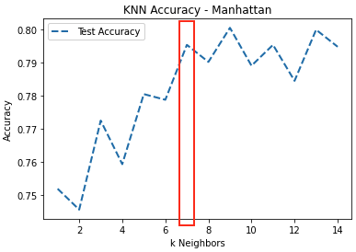
NON-LINEAR MODELS - KNN (Manhattan)
Hyperparameters
metric=’manhattan’
k=7
Results:
Confusion Matrix
Accuracy = 0.795
 | False Positive | Candidate
False Positive | 745 | 143
Candidate | 215 | 646

Slide 14
NON-LINEAR MODELS - DECISION TREES
Default Parameters
Confusion Matrix
Accuracy = 0.801
max_depth=6
Confusion Matrix
Accuracy = 0.831
ccp_alpha=0.000135
Confusion Matrix
Accuracy = 0.803
 | False Positive | Candidate
False Positive | 728 | 160
Candidate | 188 | 673
 | False Positive | Candidate
False Positive | 811 | 77
Candidate | 218 | 643
 | False Positive | Candidate
False Positive | 730 | 158
Candidate | 187 | 674

Slide 15
NON-LINEAR MODELS - RANDOM FOREST
Preprocessing:
Remove Near Zero Variance Predictors
Remove highly correlated predictors
Normalize data
Results:
Confusion Matrix
Accuracy = 0.846
 | False Positive | Candidate
False Positive | 749 | 139
Candidate | 130 | 731

Slide 16

RESULTS AND
FINAL MODEL
SELECTION
Support Vector Machine
Accuracy = 0.851

Slide 17
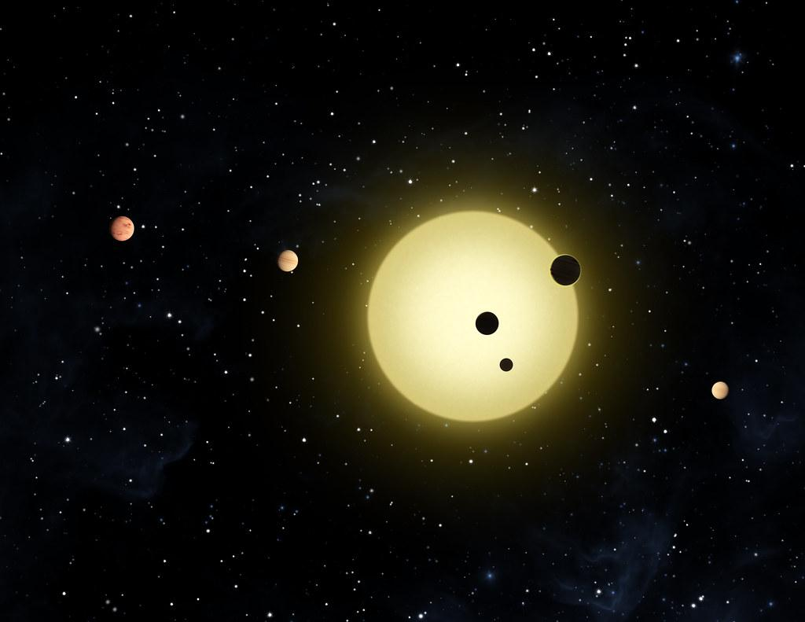
DISCUSSION AND CONCLUSION
Exoplanet classification and why does it matter?
Redefining our understanding of what constitutes a planet
Let’s look at Pluto

Slide 18
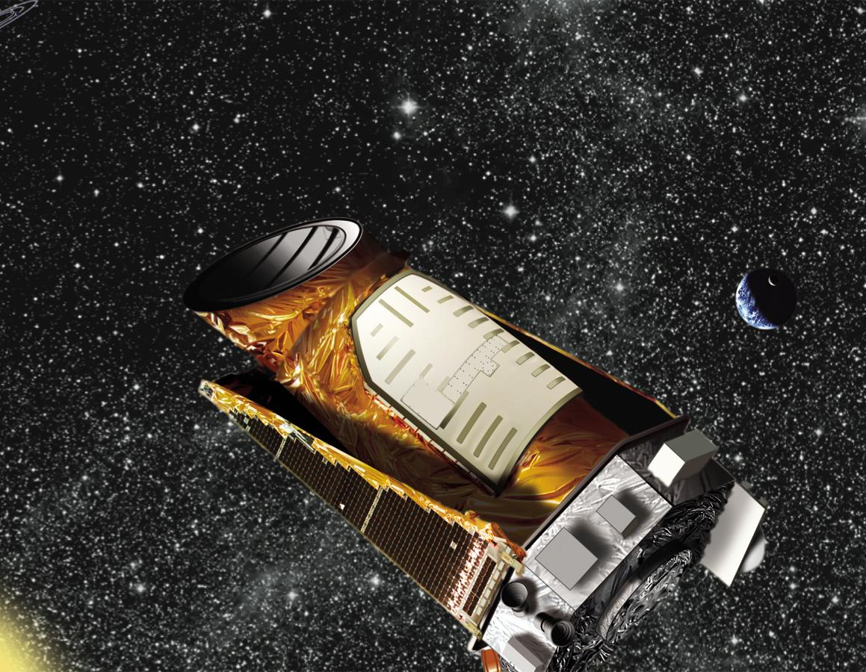
References
Kaggle. (2022). NASA Exoplanet Data Set. https://www.kaggle.com/datasets/arashnic/exoplanets
National Aeronautics and Space Association. (2022, 15 August). Kepler’s legacy: discoveries and more. https://exoplanets.nasa.gov/keplerscience/
Bali, R., Sarkar, D., & Sharma, T. (2018). Practical Machine Learning with Python. A Problem-Solver’s Guide to Building Real-World Intelligent Systems. Apress.

